Slide 1
ON JOB TRAINING
PRESENTATION
AIRLINES DELAY CLASSIFICATION

Slide 2
TULJARAM CHATURCHAND COLLEGE ART,SCIENCE AND COMMERCE BARAMATI
PRESENTED BY MULIK YASHSHREE
WAGH SANJANA POMANE PAYAL
EXTERNAL MENTOR
MR.PRAJYOT PATIL
INTERNAL GUIDE
MS.POOJA GAIKWAD

Slide 3







Slide 4

Introduction about the topic
Building a flight delay classification model using machine learning. In this project, we use historical airline data from Kaggle to predict whether the arrival of a passenger flight will be delayed or not. We approach this problem as a classification problem, predicting two classes: delay or no delay.
In this experiment we train different model which indicates the appropriate categorical class for each model.
The airline dataset has 8 different features: Airline, Airport From, Airport To, Length, Time, Flight, and ID. The target variable is Delay

Slide 5
Objective
The task will be predict whether a given Flight will be delay or not delay, Given the information of the schedule departure.
To determine which model is best for airline delay classification.
To identify which feature is important for flight delays.

Slide 6
EXPLORATORY
DATA
ANALYSIS

Slide 7
Data preprocessing
Import necessary libraries
Import dataset
Checking missing values
Shuffling the data
Drroped unnessesary data

Slide 8
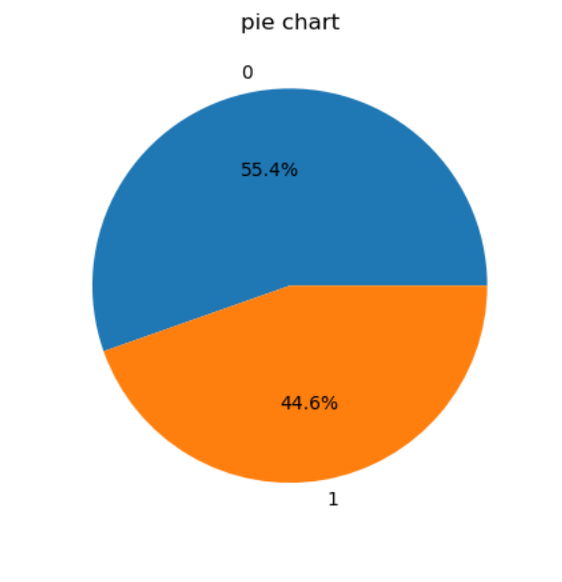
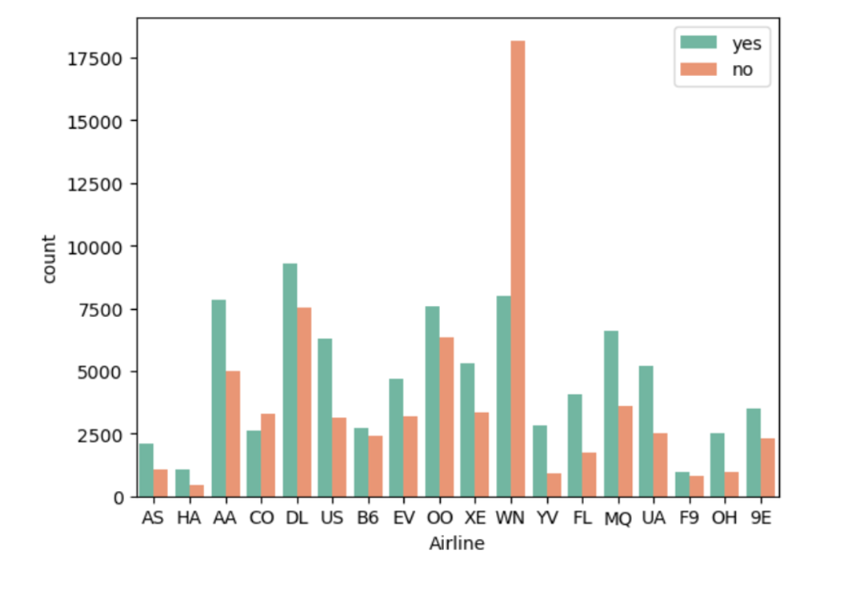
Delay
No delay
From the pie chart we observed that
percentage of the delayed is more
than not delayed.

Slide 9
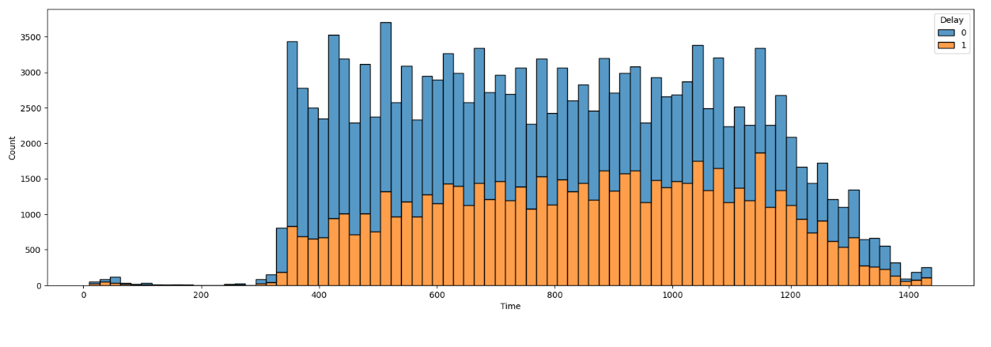
0-360 : Mid-night
360-720 : Morning
720-960 : Afternoon
960-1140 : Evining
1140-1440 : Night
From this plot, we conclude that the maximum airline travel occurs from morning to evening.

Slide 10
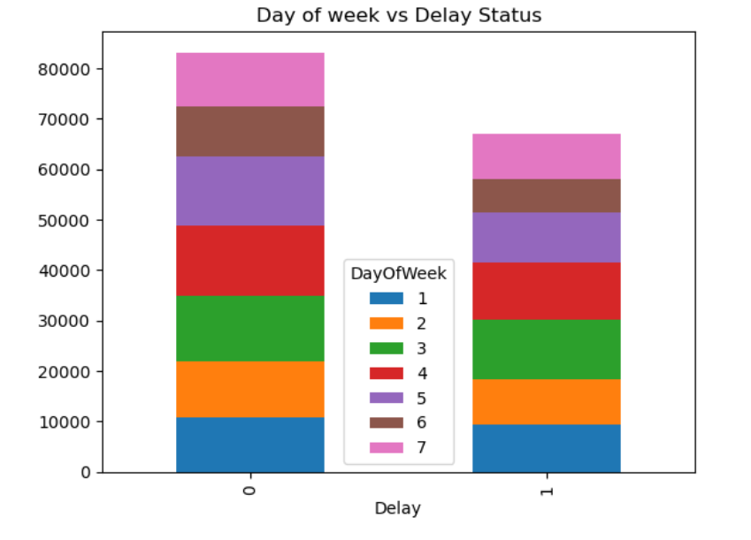
From this plot we observed that Wednesday,Thursday and Friday has maximum rate of delay Airlines compare to other days in a week .

Slide 11
Model Building
1.Spliting the data into train test.
2.We split the data into 80% train data and
20% test data.
3.We build the model on train data and predict on
the test data.

Slide 12
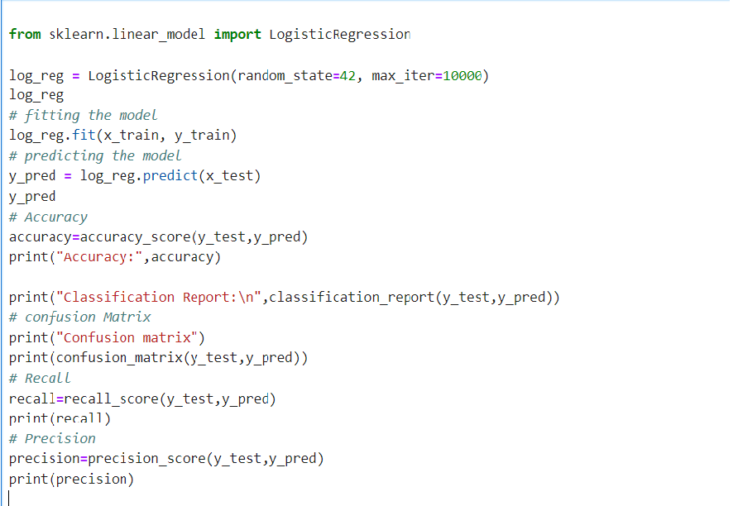
We build the model using Logistic Regression
The same process for Remaining algorithms:

Slide 13
Similarly we build other models like:
1.LOGISTIC REGRESSION
2.NAÏVE BAYES
3.RANDOM FOREST
4.KNN
5.DECISION TREE
6.BAGGING
7.GRADIENT BOOSTING
8.XG BOOST
9.ADA BOOST
10.MPL

Slide 14
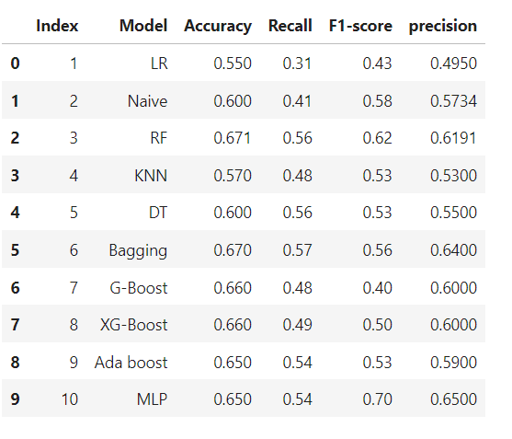
BEFORE GRID SEARCH CV

Slide 15
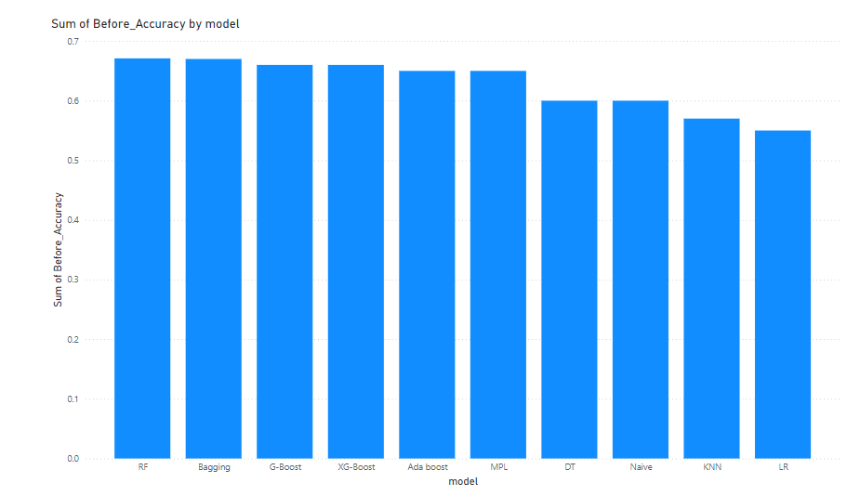
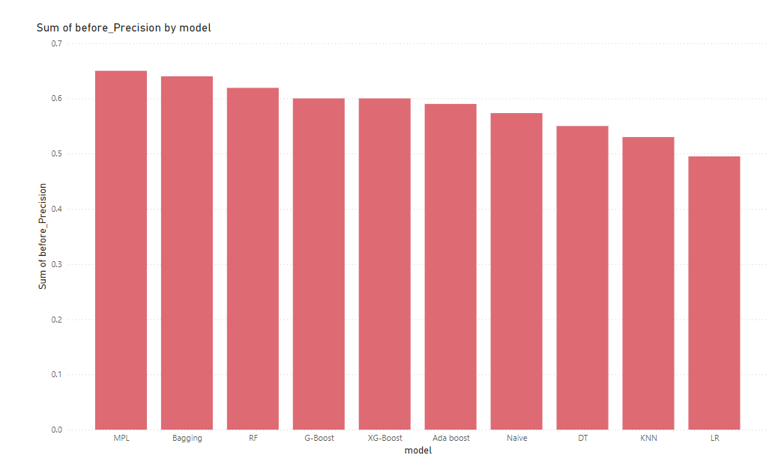
From this plot we conclude that RF and Bagging algorithm have highest Accuracy.
From this plot we conclude that and MPL Bagging algorithm has highest Precision.

Slide 16
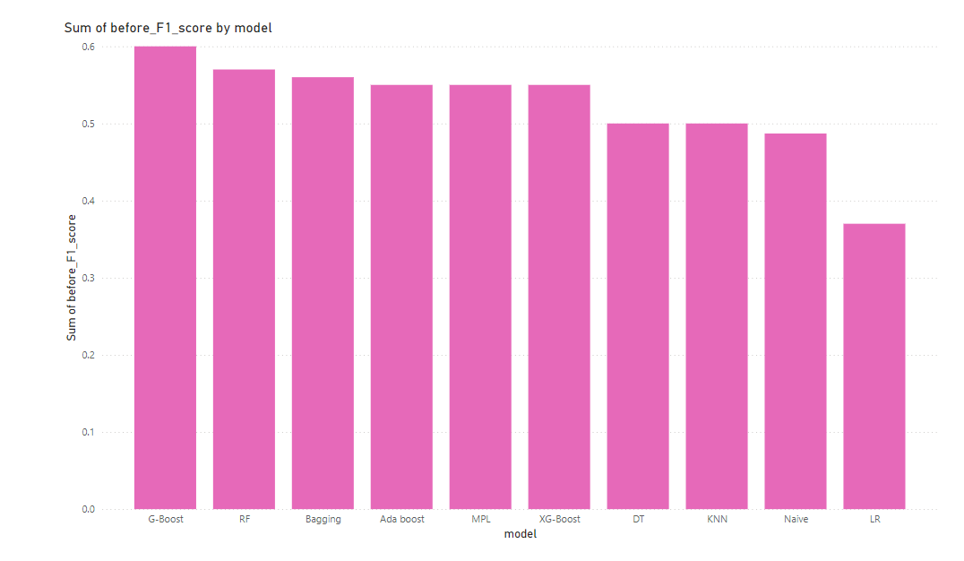
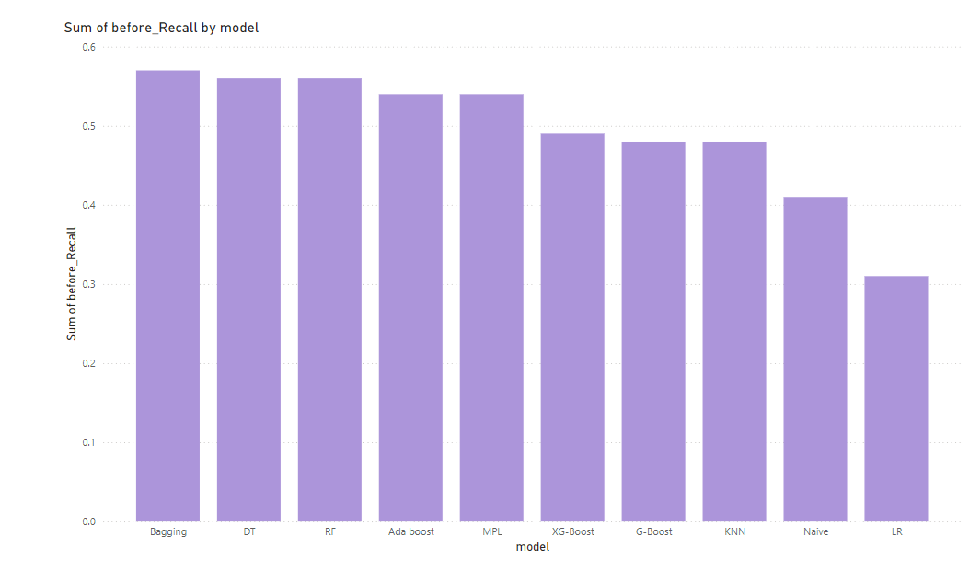
From this plot we conclude that Gradient Boosting algorithm have highest F1-Score.
From this plot we conclude that Bagging algorithm have highest Recall.

Slide 17
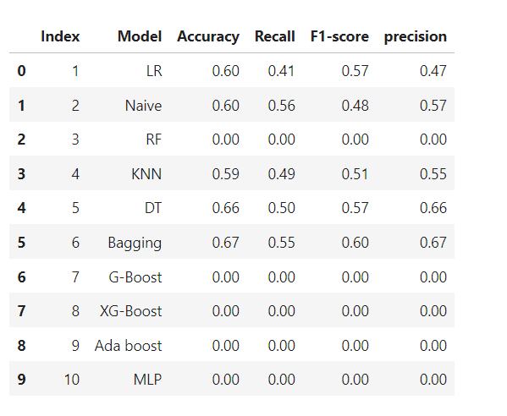
AFTER GRID SEARCH CV

Slide 18
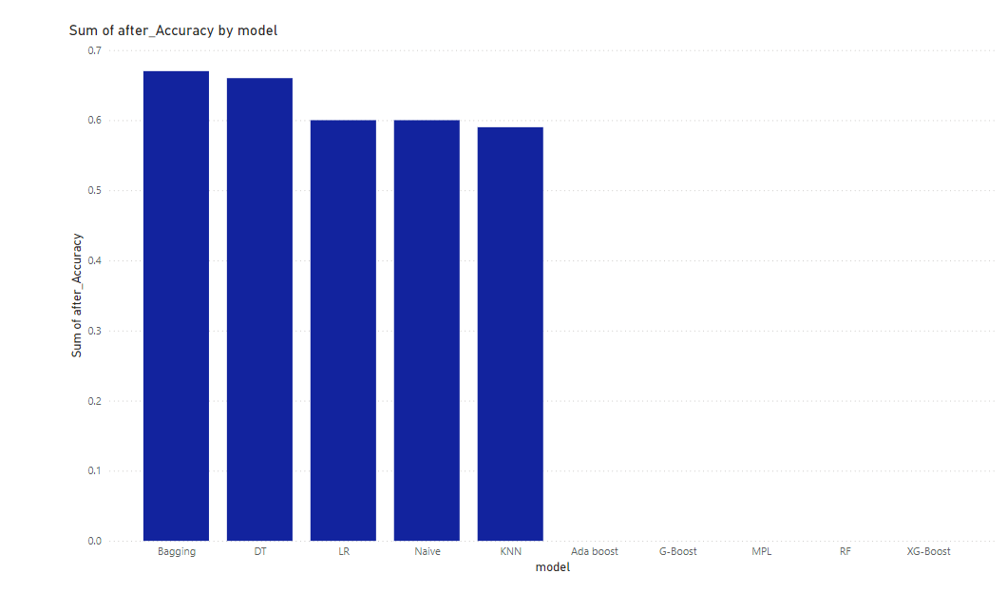
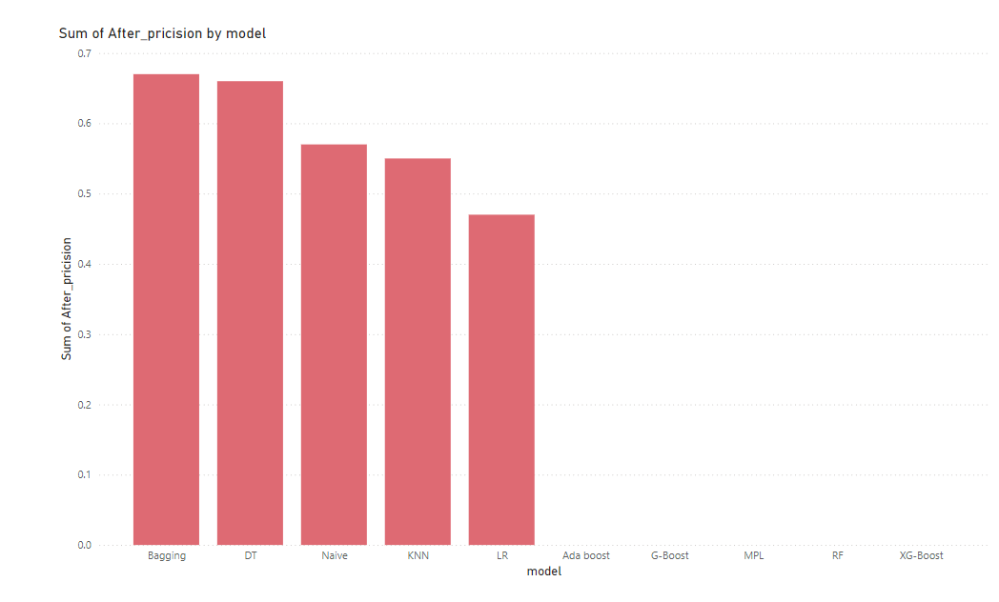
After using Grid search CV we conclude that that Bagging have highest Acuuracy.
After using Grid search CV we conclude that that Bagging have highest Precision.

Slide 19
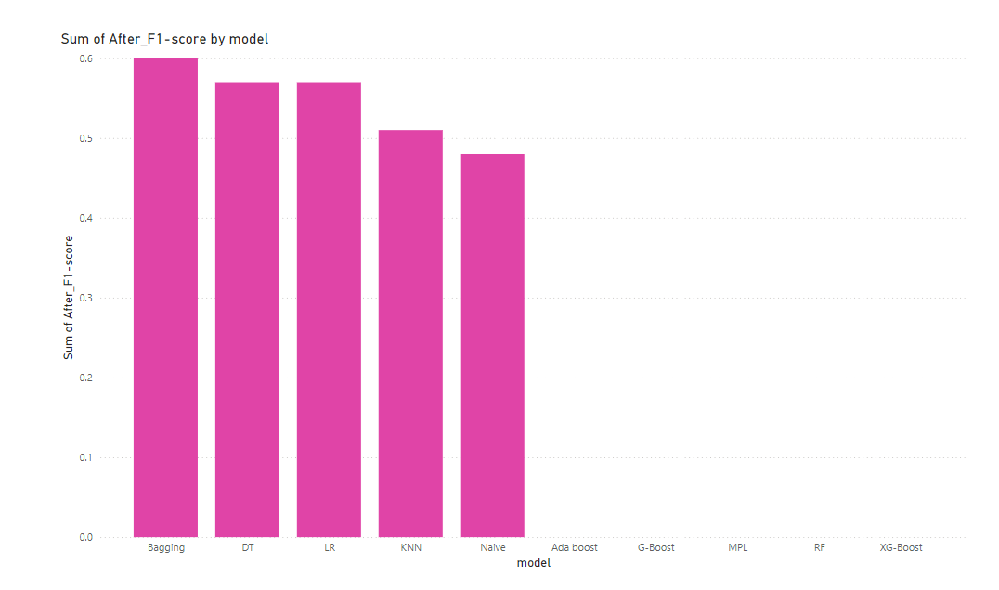
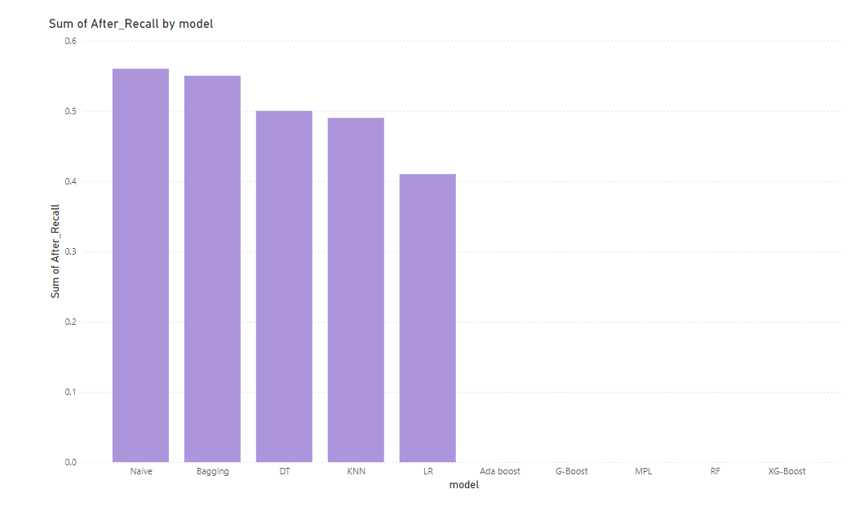
After using Grid search CV we coclude that that Bagging have highest F1-Score.
After using Grid search CV we coclude that
Naïve Bayes and Bagging have highest Recall.

Slide 20
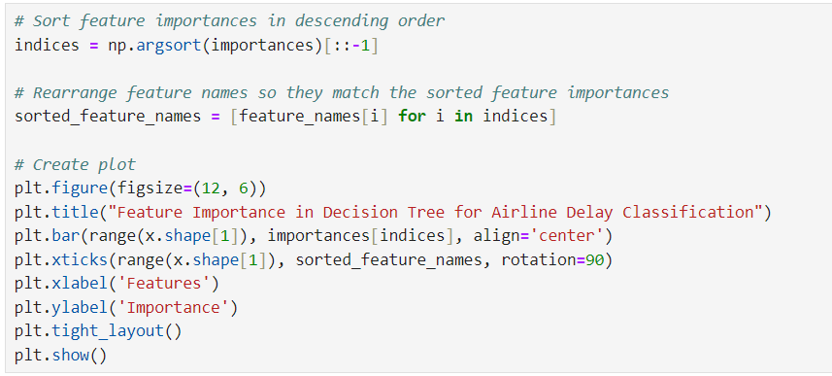
We use the Decision Tree algorithm for Feature importance as follows :
features_importance=dt.feature_importances_
importance_df=pd.DataFrame({"feature":x.columns,"Importance":features_importance*100})
importance_df=importance_df.sort_values(by="Importance",ascending=False)
importance_df

Slide 21
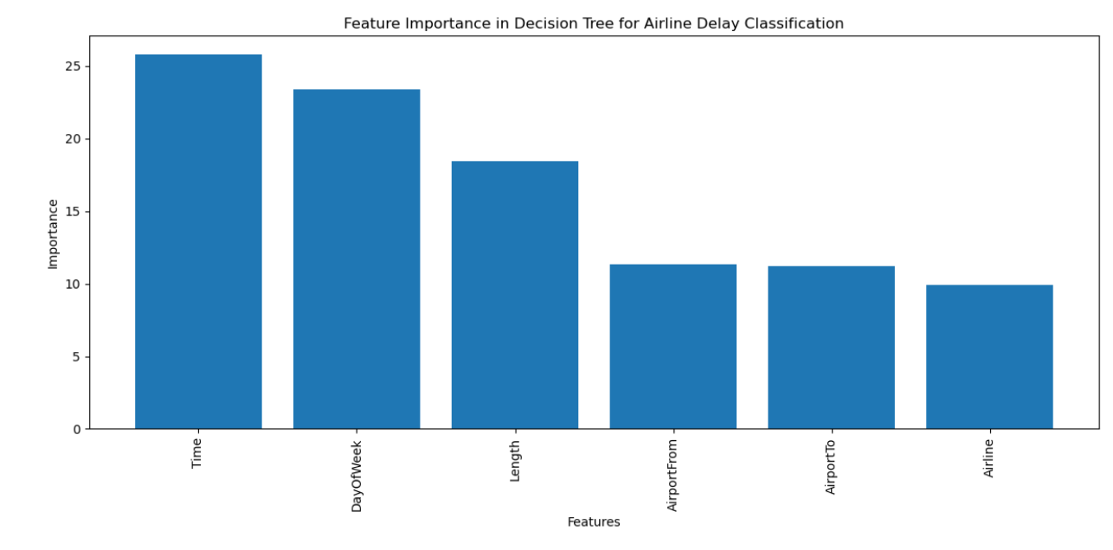
FEATURES IMPORTANCE
From this plot,we conclude that only three features are important:Time,Dayofweek,and Length.

Slide 22
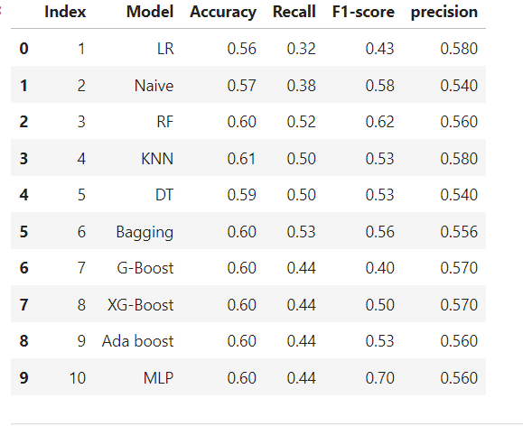
VARIABLE SELECTION

Slide 23
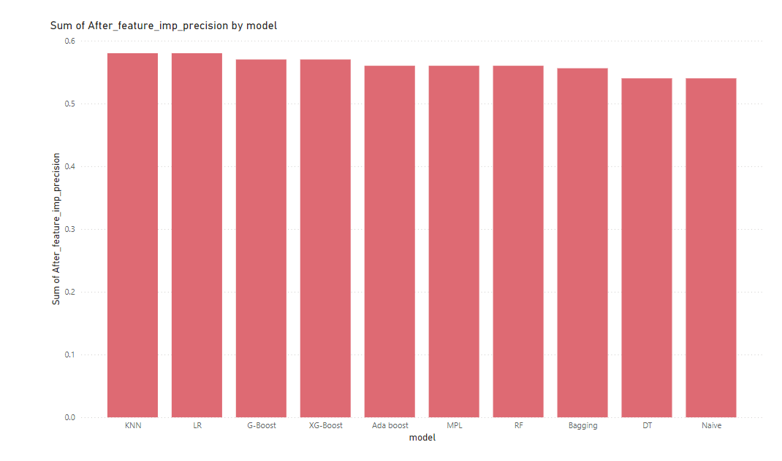
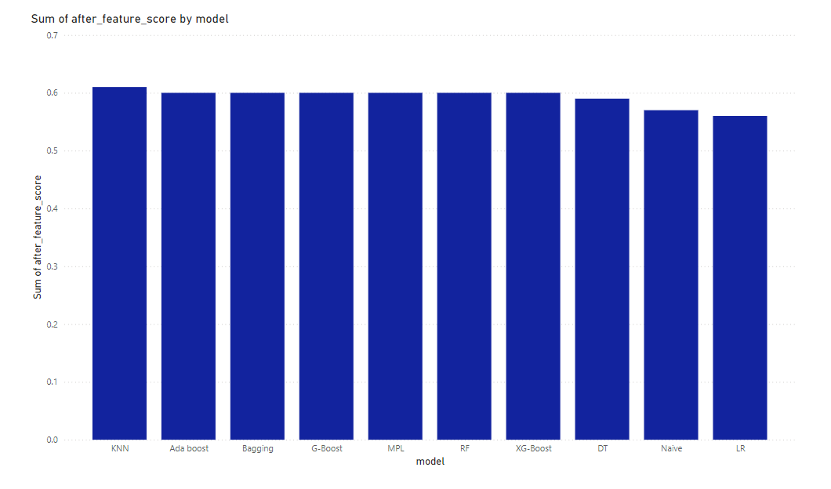
After using Feature Importance we conclude that KNN and LR have highest
Precision.
After using Feature Importance we conclude that KNN have highest Accuracy.

Slide 24
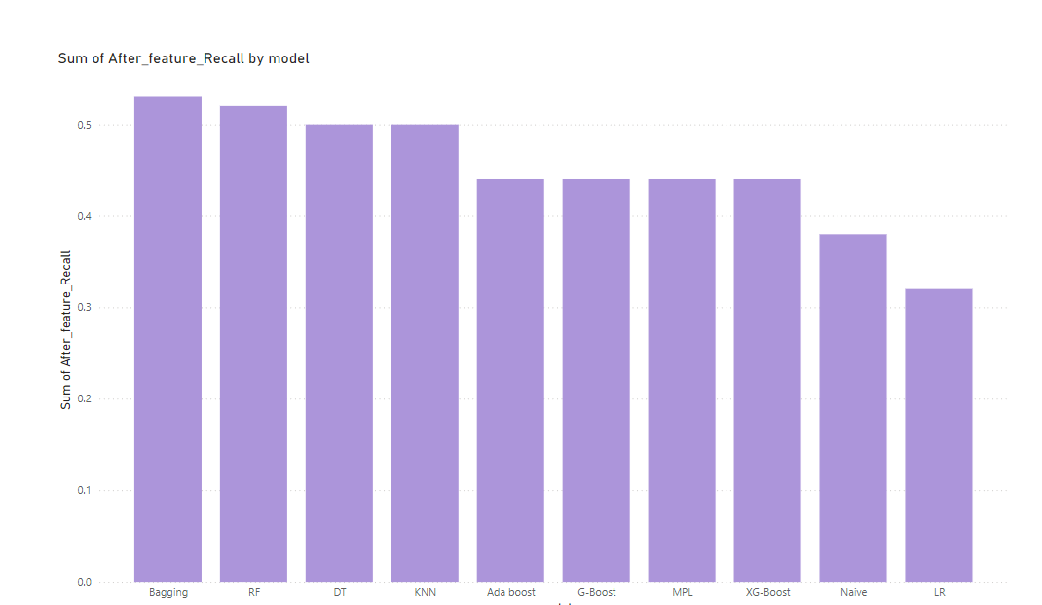
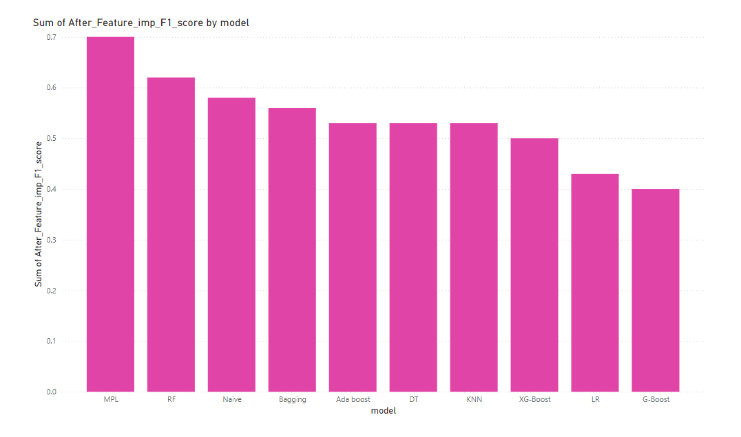
After using Feature Importance we conclude that Bagging have highest Recall.
After using Feature Importance we conclude that MPL have highest F1-Score .

Slide 25
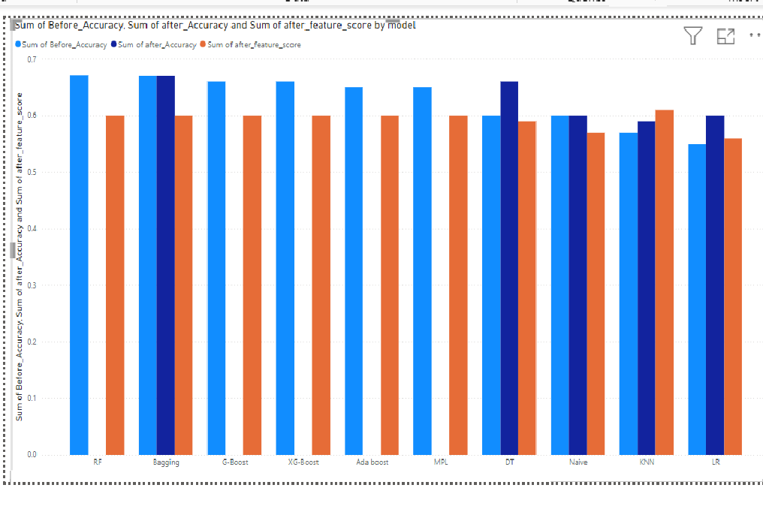
Comparison between accuracy

Slide 26
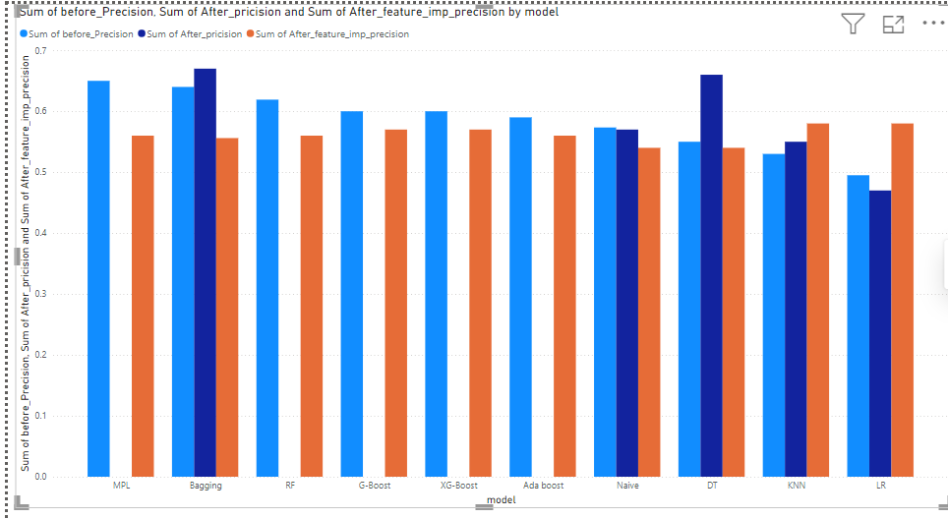
Comparison between Precision

Slide 27
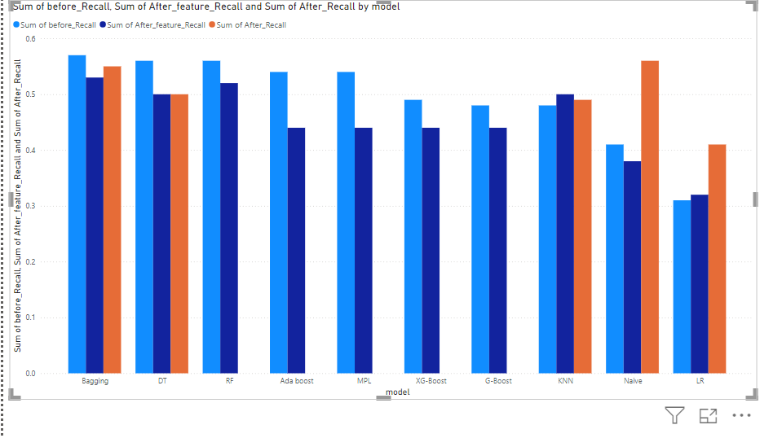
Comparison between Recall

Slide 28
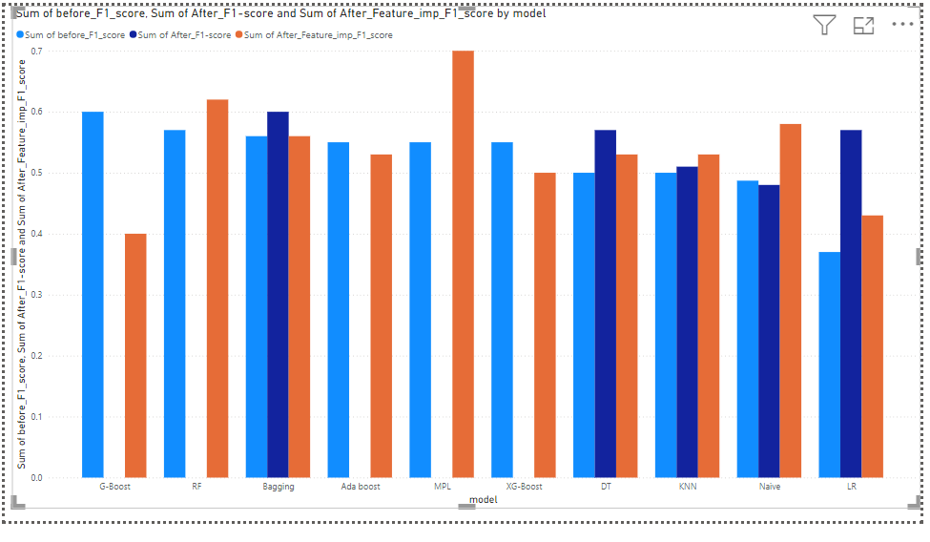
Comparison between F1-Score

Slide 29
Conclusion
From this project, we conclude that the baseline prediction of delays has 55% accuracy, We improved the accuracy by around 12% using the best model, the Random Forest Model.
After using Grid Search CV, we observed that there is no significant change in the accuracy.
After selecting the important features, we observed that there was no significant change in accuracy.

Slide 30
Thank
You

